Slide 1
INTELLIGENT SMART CONTAINER LOCKS
11 December 2025
1

Slide 2


Container corridor
Schematic Overview: security hotspots, community risk areas, route diversions
Community Encroachment:
Kwa-Tandaza-Georgedale; Cliffdale station to Bux Farm Level Crossing; Menzine Tunnel to Klaarwater; Business Forum disruptions
Pyramid
South
Umbuluwane, Danskraal, Uithoek Signal Theft hot spot.
Mandini
Sentrarand
  2,1
Community Work Interruption and Business Forums during annual Shutdown – Greylingstad, Balfour North, Heidelberg
Stanger
Rosslyn
Stilwater
Pretcon Terminal
Community encroachment at Rooikop
Escourt, Frere, Rosetta, Cato Ridge Community Unrest
Durban
Station
Point
Capital Park
Watloo
Rosslyn
Watloo
Maydon Wharf
Newcastle
Danskraal
(Ladysmith)
Cato
Ridge
Durban
Goods
Work Stoppage by Business Forum
Kaalfontein
Isando
Germiston
Rietvallei
Escourt
Kaalfontein Car Terminal
Union
Booth
Kaydale
Vooruitsig
Glencoe
Pietermaritzburg
Bayhead
Harrismith
Masons Mill
Mt Vernon
Rossburg
Umbilo
City Deep Terminal
Kascon Terminal
Community Unrest in Standerton – shutdown works impacted
King’s Rest
Kingsrest Buffer
Driemanskap – Mapelton - Rooikop – OHTE Theft hot spot.
Racecourse
Bethlehem
Fynnland
Bridge
Grindrod
SACD
Natalspruit
Kazerne
City Deep
Branchlines
Isipingo
Isipingo Car Terminal
Wentworth
Natalspruit
Kroonstad (Gunhill)
South Coast Work Stoppage by Business Forums
Island view
Umkomaas
Wests
Key Challenges:
Exposed Cables across the Network.
Vegetation and Service Road Conditions.
Slot Capacity reduced due to OHTE and signal Theft across the network
Continuous operational disruptions; high cost of replacement; planned maintenance impacted; customer quality of service impacted
Rural development and informal housing along railway reserve on either side is increasing ; Topographical and geographical layout of the track in relation to the reserve makes it difficult to distinguish boundary lines; Children and adults cross the tracks to gain access to roads on the opposite sides to access transportation to school and work; No access due to poor municipal town planning and land invasion of informal development.
Port Shepstone
Reef feeder lines
Container Cor pipe (~670 km)
Durban destinations

Slide 3
Purpose of the project
Given the high level of losses associated with theft of containers and cargo, TRIM, intends to implement an intelligent driven smart container locking system and services contract to reduce theft of containers and cargo in transit, Marshalling Yards, as well as Container Terminals.

Slide 4
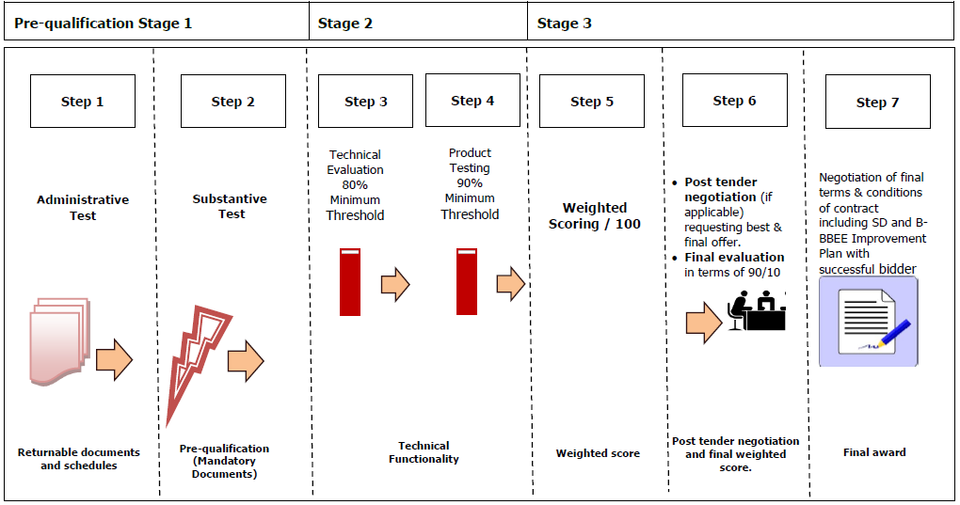
Evaluation criteria
Transnet will utilise the following methodology and criteria in selecting a preferred Bidding company

Slide 5
THANK YOU

